Slide 1

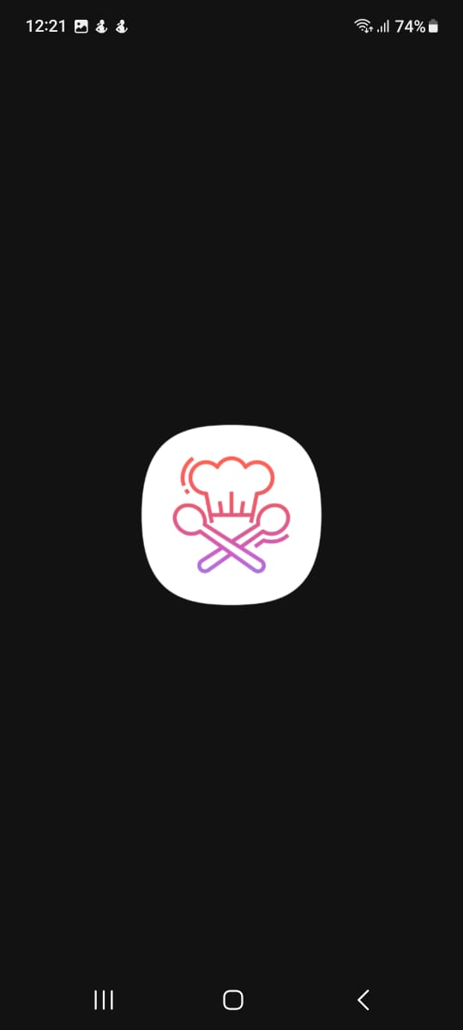
Mobile Cooking App
Khana Recipe
Yimekxana
Ikram Mammadov

Slide 2
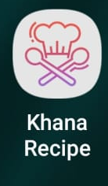
Layout
In layout section I menant how my app works like this goes here that goes the in below there is detailed graph
Side Menu
Profile
Login
Home
Login/Register
Search
Register
Filter

Slide 3
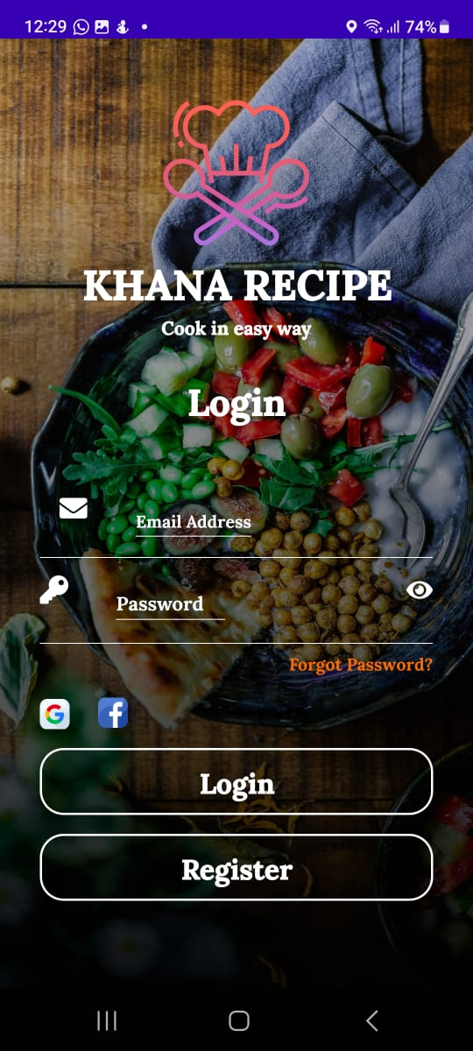
Login / Register
This is the default page that user choose depepending on if they have account or not.If they have account there is no need to go to Register

Slide 4
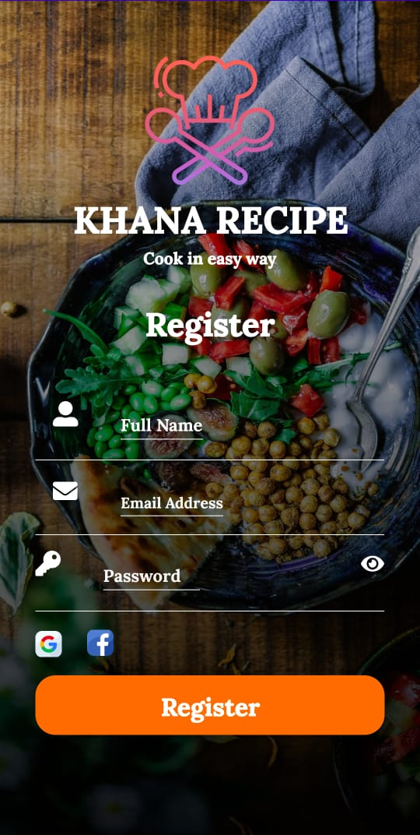
Register
This is the page new uses must complete to get their account in near future I am thinking amout adding guest mode with limited options

Slide 5
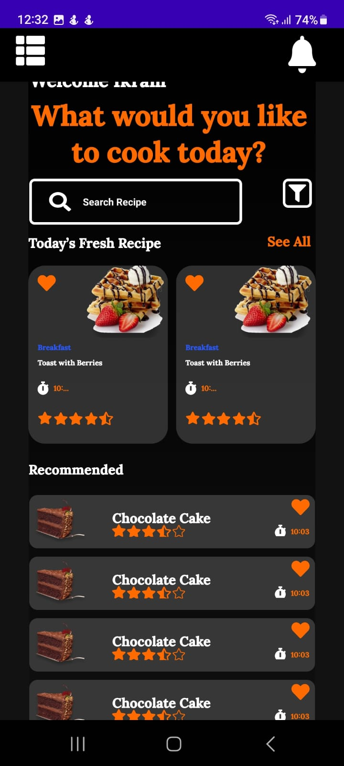
Home
This is the default page that registered user sees From here user can go to side menu ,recommended, filter and search recipe

Slide 6
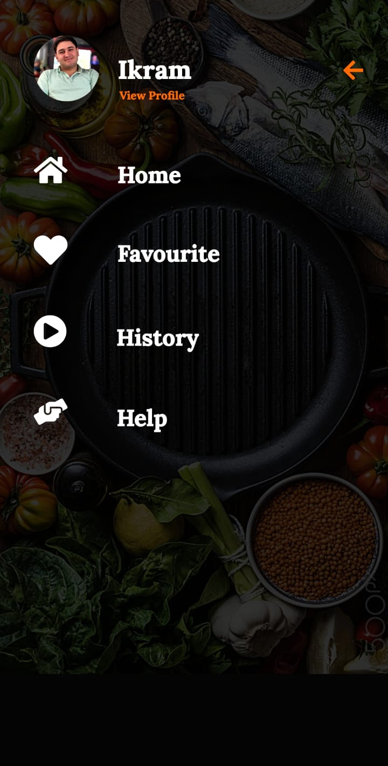
Side Menu
Side menu is like navigation bar form here user can return to Home,Favorites,History(not currently active),Help(myself), functions

Slide 7
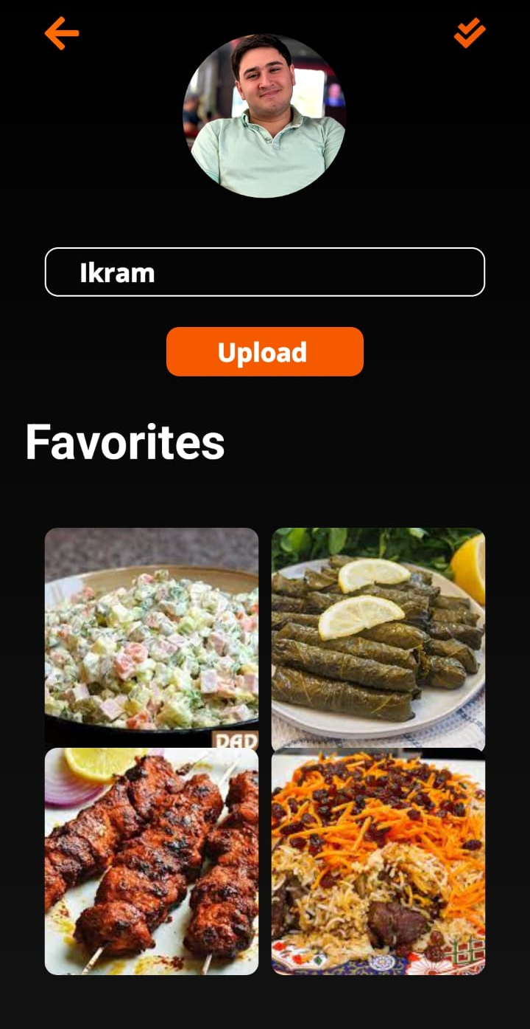
Profile
This is Profile in profile It shows little datail about yourself, Favorite additions and choice to upload your own recipes

Slide 8
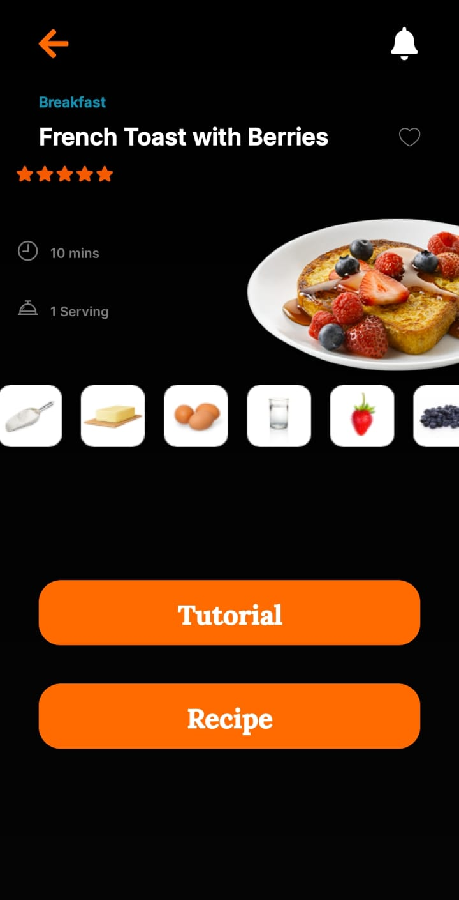
Recipe
As name implies clicking on recipes opens you know already Recipe panel this is where in formation about recipe shows up. It has two functions Tutorial and Recipe both of them are nearly same functions but Implemented function of tutorial is to show Youtube wideo in picture mode. The Recipe function is like note book it says do tis do this and that

Slide 9
Ending
This is the the end thou there is much to talk about I wanted this presentation to simple insight to what can possibly be is I continue to learn.

